Slide 1
Object Objected Programming
Team 8
w/ 7even Guys
Infinite Integer Calculator

Slide 2
Demonstration

Slide 3
Goals
Addition
Subtraction
Multiplication
& Division

Slide 4
Goals
What is GOOD program?

Slide 5
Goals
What is GOOD program?
BACKed-UP program.

Slide 6
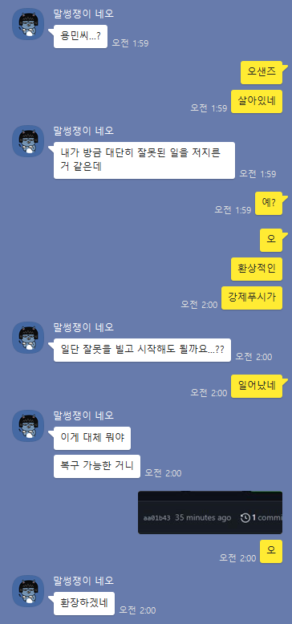
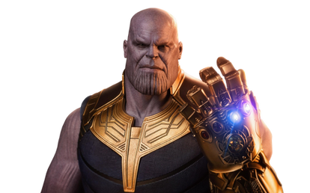
Sir..
Why are u wake
I think I ruined
everything..
omg
Forced push happend
I’m so sorry
What the…
Is recovery possible?
Oh
Jesus Christ

Slide 7
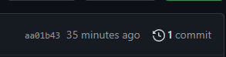

Slide 8
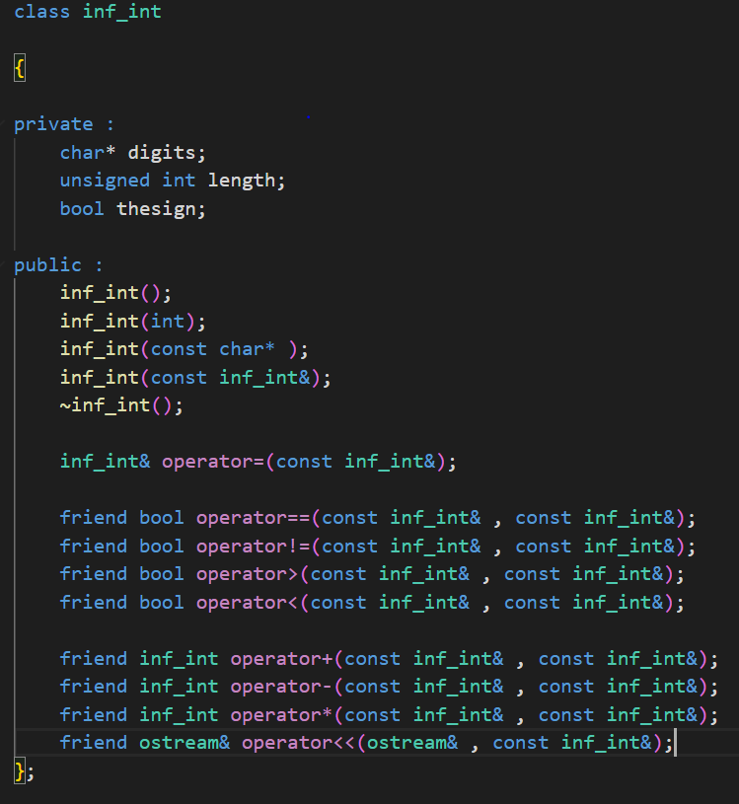
Functionality
Basic arithmetic
functions
Comparison &
I/O function

Slide 9
Implementations
Constructors
Store digits in Char Type
2.Dynamic Allocation

Slide 10
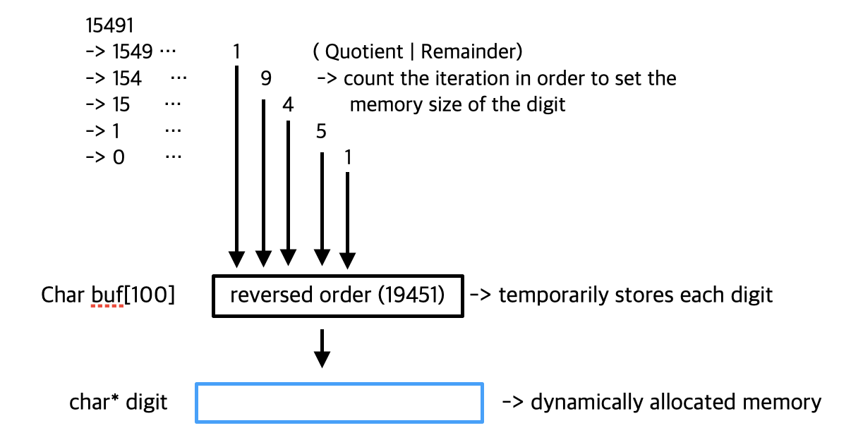
Implementations
Constructor
Integer type

Slide 11
Implementations
Constructor
Data type
Digits should be stored in reverse value

Slide 12
Implementations
Constructor
Copy Constructor

Slide 13
Implementations
Constructor
Default constructor
Initialize the internal members

Slide 14
Implementations
Destructor
To free the digits ( Since we allocated memory dynamically )

Slide 15
Implementations
Comparator
Relational Operator
Compare sign
Compare length
Or compare from the end of the digit array

Slide 16
Implementations
Comparator
Others
Compare length
Or compare from the end of the digit array

Slide 17
Implementations
Comparator
Shallow vs Deep Copy
Save memory
Ensure that digits are not changed

Slide 18
Arithmetic Operator
Carry
Char to Int

Slide 19
Arithmetic Operator
Add Sub
Since arithmetic operators do not always perform its original operations.

Slide 20
Arithmetic Operator
Add
C
=> Initialized with 0

Slide 21
Arithmetic Operator
Add
4 5 3 9 1
4
5 3 9 1

Slide 22
Arithmetic Operator
Add
2 1 9 2 8
4 5 3 9 1
1
1
1
6 6 2 2 0
1

Slide 23
Arithmetic Operator
Sub
Similar as the addition
If result is smaller than 0
Carry occurs and 1 will be stored in the next index.

Slide 24
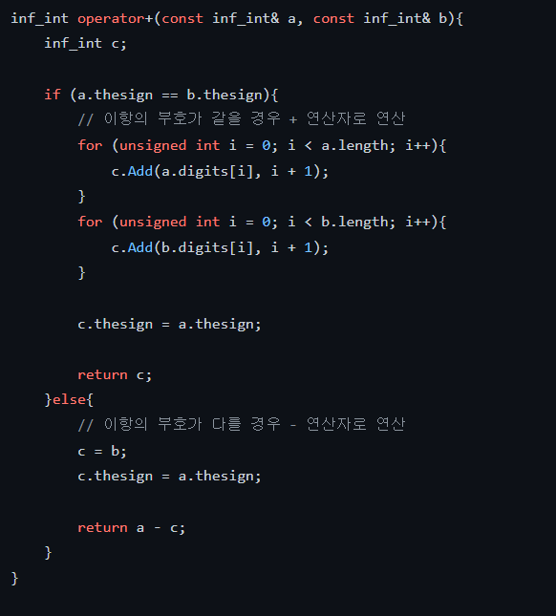
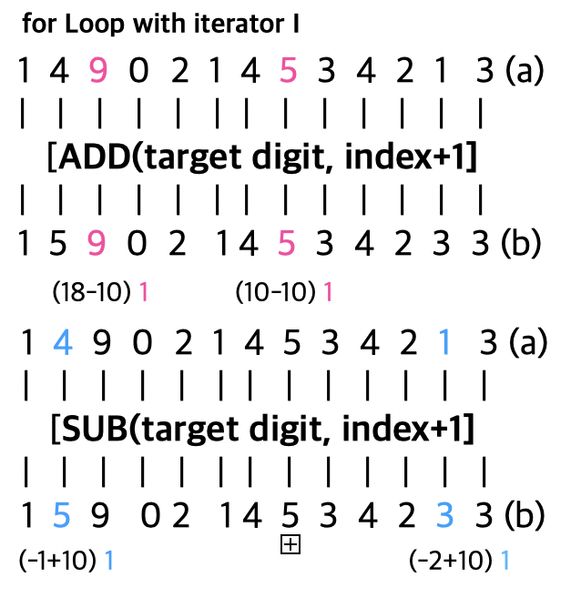
Arithmetic Operator
+

Slide 25
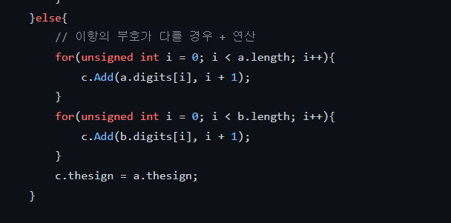
Arithmetic Operator
-
Positive - Negative
Negative - Positive

Slide 26
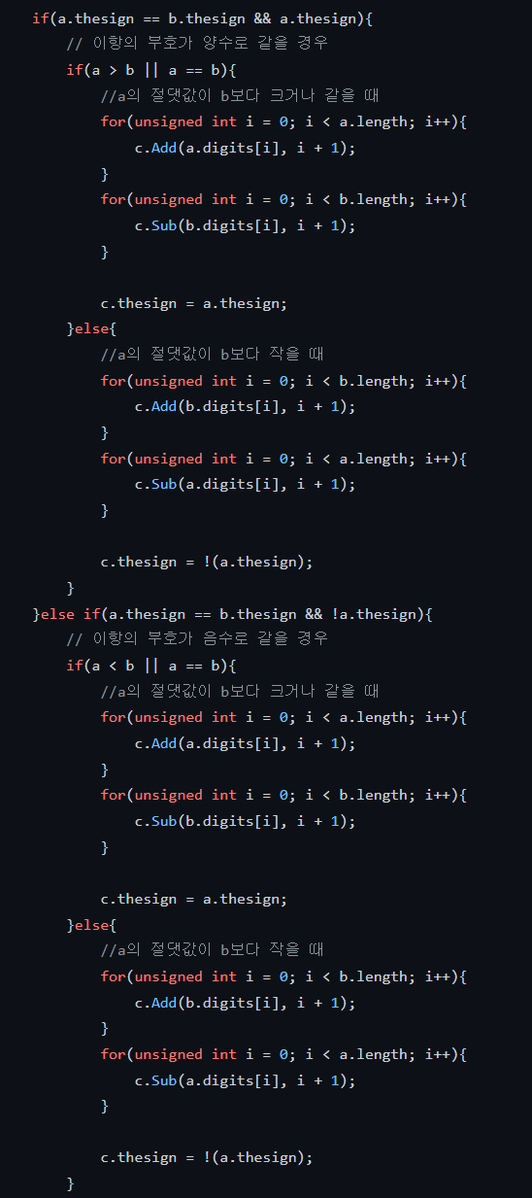
Arithmetic Operator
-
Positive - Positive
Negative - Negative

Slide 27
Arithmetic Operator
Multiplication
& Division

Slide 28
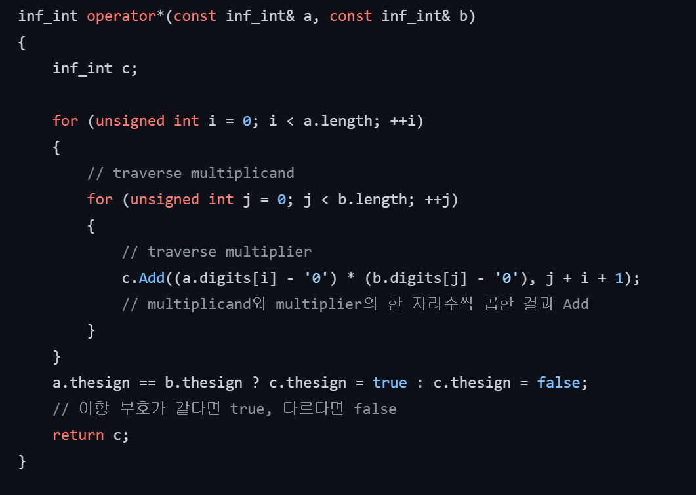
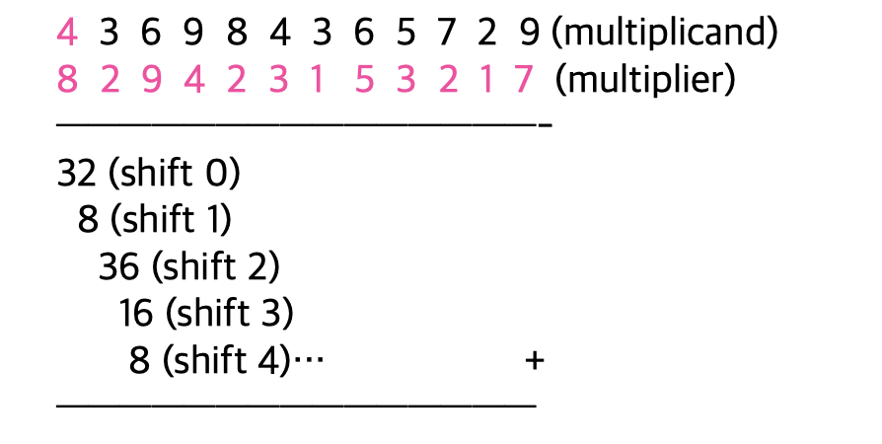
Arithmetic Operator
Multiplication

Slide 29
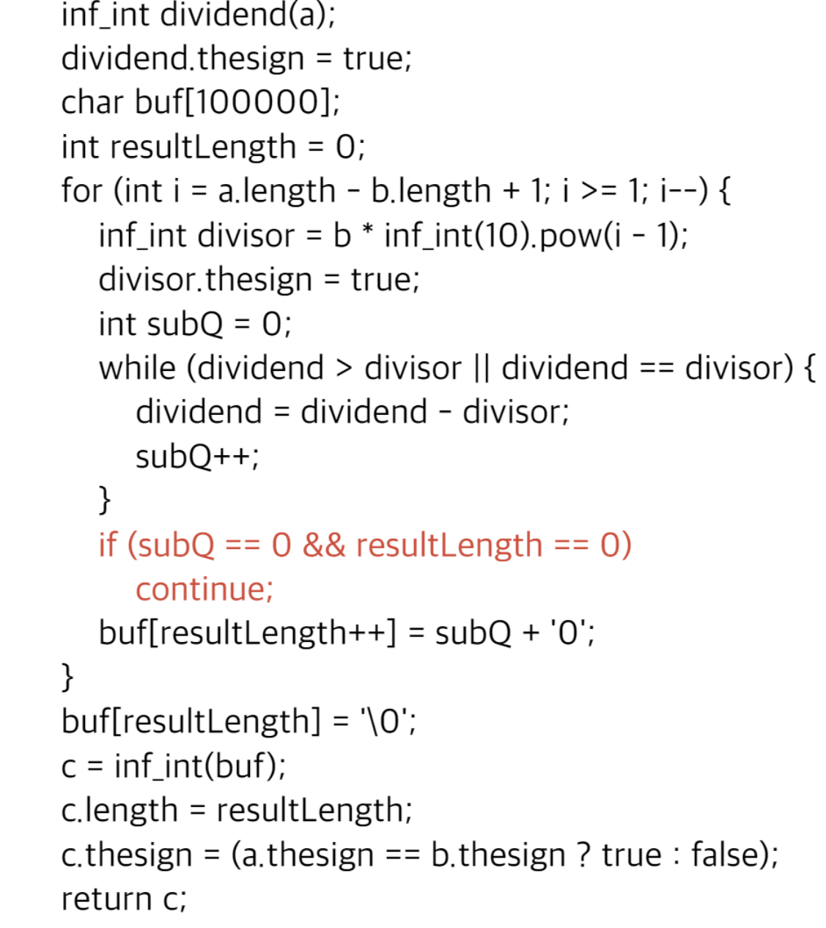
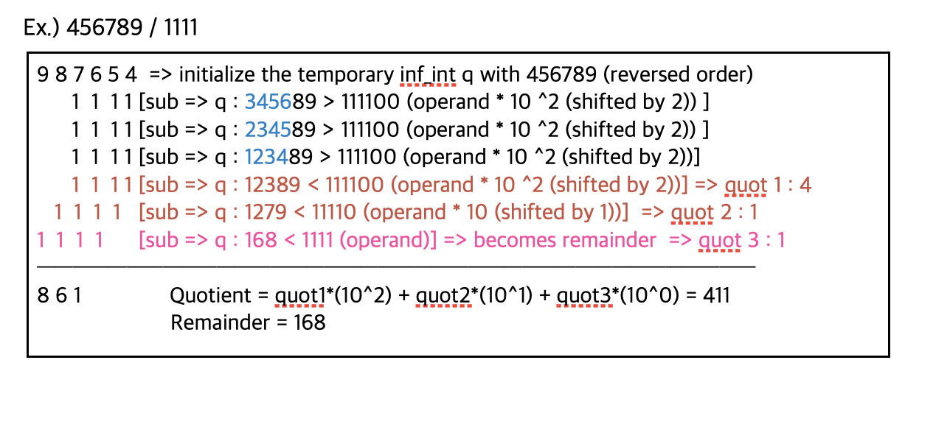
Arithmetic Operator
Division

Slide 30
GUI Implementation
QT for C++

Slide 31
What is GOOD program? AGAIN

Slide 32
감사합니다.
Thank you

